Slide 1






Slide 2


THE PROBLEM
-Low customer retention by brands
-Low and expensive redemption rates
-Time delays and expiry of loyalty points
-Hard to value the loyalty points
( G E N E R A L L A C K O F A D E Q U A T E D I G I T I Z A T I O N )

Slide 3
THE SOLUTION
-More customer engagement through rewards.
-Wallets to view, redeem, send/receive loyalty tokens
-Automation in issuing and managing
loyalty tokens
-Fiat backed loyalty tokens
( U S E O F B L O C K C H A I N T E C H N O L O G Y I N L O Y A L T Y P R O G R A M S )

Slide 4
WHAT IS GEMA?
GEMA is a blockchain solution that helps brands in creating, issuing and managing loyalty tokens through stablecoins/fiat currency.
A R E C E N T S T U D Y F R O M B A I N A N D
C O M P A N Y S U G G E S T S
T H A T A 5 % I N C R E A S E
I N C U S T O M E R R E T E N T I O N C O R R E L A T E S
W I T H A T L E A S T A 2 5 % I N C R E A S E I N P R O F I T .

Slide 5


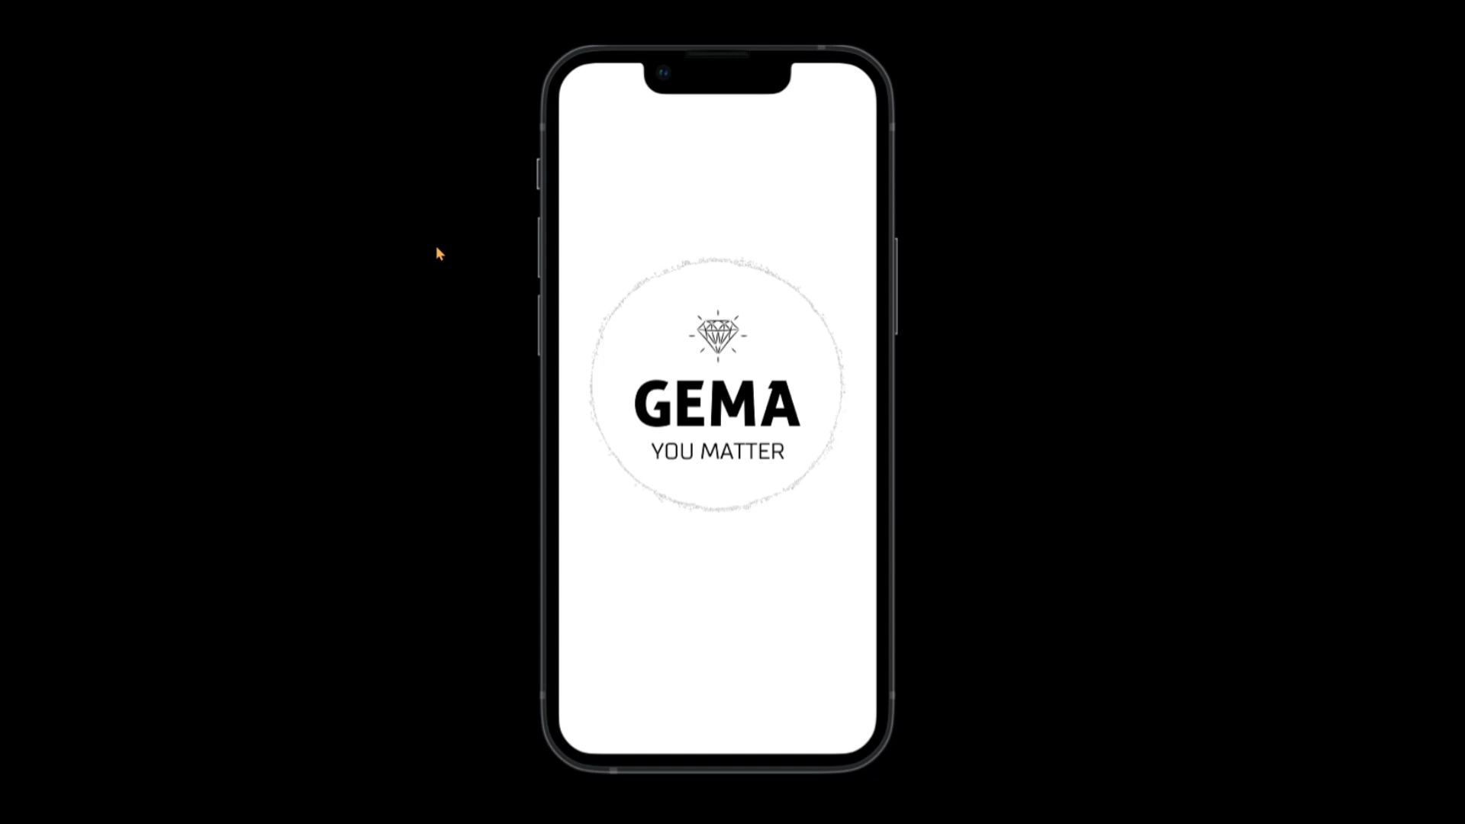
HOW GEMA WORKS?

Slide 6

THE GEMA BLOCKCHAIN?
The GEMA Ecosystem constitutes: The GEM token.
Smart contracts.
Different brand blockchains .
GEMA Mobile App/Web App where users be able to send, receive, view and redeem their loyalty tokens.

Slide 7
MARKET SIZE
$ 75B
GLOBAL MARKET
.
18.7%
Occupied market share

Slide 8
BUSINESS MODEL
We charge 3% on the amount co.llateralized by the brands as fees
Total Market Kenya
1% revenue Staked
Fees-3%
$ 3.6B
$ 36.8M
$ 1.08M

Slide 9
COMPETITION
Star Alliance being a company that has formed an alliance with most airlines for miles redemption at hotels and management of tier services has already established a connection with over 25 airlines and 1200 airports.
QUIBEE is also domain specific on brands that work with each other and their model of token allocation is quite different for the tokens awarded to consumers are volatile.

Slide 10

GO-TO MARKET
GEMA aims to define a product-market loyalty solution according to same needs. To define a minimum viable segment to sell the minimum viable product. To dominate and lead in smaller targets because people reference according to the same needs, resulting in a minimum repeatable product which maintains the same functionality across the market.

Slide 11




MEET OUR TEAM
OUR EXPERIENCE
2+ YEARS EXPERIENCE IN THE BLOCKCHAIN INDUSTRY. LED IN 2 BLOCKCHAIN SOLUTION BASED HACKATHONS.
CO-FOUNDED GEMA IN 2022. STUDYING I.T AND BUSINESS AND HOW THE BLOCKCHAINS HELPS THEM.
LINCOLN GAKUYA
FOUNDER
IMMANUEL MAINA
CO-FOUNDER

Slide 12


WE APPRECIATE YOU

